Slide 1
Introduction to Data Analytics: Course Intro
Professor Ian Nabney
ian.nabney@bristol.ac.uk

Slide 2
Overview
Structure of the unit
Information Visualisation (Prof. Ian Nabney): how to make sense of digital data by distilling and displaying it using an appropriate visualization technique. This unit introduces the science of information visualisation, covering topics such as data and task abstraction, visual thinking and how to arrange information for visualisation. The lectures will be accompanied by lab exercises using the interactive visualisation platform Tableau.
Text Analytics (Dr. Edwin Simpson): how to process natural language to extract information and identify patterns and trends, e.g., through sentiment analysis. This unit introduces natural language processing using rule-based and statistical machine learning methods for tasks such as text classification, sequence tagging, clustering, dependency parsing and relation extraction. Lectures will be accompanied by lab exercises using Python and Jupyter notebook.
Why visualise data?
How we can visualise data

Slide 3
Week | Asynchronous Content | Lectorial/Discussion | Lab Class
1 | Information visualisation: overview of InfoVis and Data Abstraction | Data abstraction | Introduction to Tableau
2 | Information visualisation: task abstraction and marks | Visual queries | Basic Visualisation in Tableau
3 | Information visualisation: arranging tabular and non-tabular data | Visual search | Graphs in Tableau
4 | Text analytics: introducing natural language processing, regular expressions, preprocessing | Rule-based text processing and preprocessing | Regular expressions and tokenisation with Python
5 | Text analytics: classification and sentiment analysis with naïve Bayes and logistic regression | Text classification and sentiment analysis | Implementing sentiment classifiers with Python
- | READING WEEK
6 | Text analytics: document clustering, topic modelling, and vector representations of meaning | Text clustering | Latent Dirichlet allocation with Sklearn or Gensim
7 | Text analytics: sequence labelling, HMMs, Conditional Random Fields (CRFs) | Sequence labelling | Sequence taggers in Python with HMMLearn and CRFStuie
8 | Text analytics: named entity recognition, dependency parsing | Information extraction and syntax parsing | Sequence taggers (continued)
9 | Text analytics: relation extraction | Information extraction continued | Coursework
- | SPRING VACATION
10 | Information visualisation: reduction and mapping marks | Visual thinking | Coursework
11 | Information visualisation: info vis summary and conclusions | Reflection and evaluation | None (Bank Holiday)

Slide 4
What is Visualisation?
Computer-based visualization systems provide visual representations of datasets designed to help people carry out tasks more effectively. Goal of visualisation is to present data in a human-readable way.
Visualisation is an important tool for developing a better understanding of large complex datasets. It is particularly helpful for users who are not specialists in data modelling.
Detection of outliers.
Clustering and segmentation.
Aid to feature selection.
Feedback on results of analysis: seeing what you are doing.
Two aspects: information visualisation and data projection (latter is covered in Advanced Data Analytics.

Slide 5
Information Visualisation Principles
The design space for information visualisation is huge
There is no definite ‘unique right way’ to visualise data (it is an unsupervised task).
Older texts/methods tended to fall back on simple criteria, and even aesthetics (see Tufte, in himself a considerable step forward).
While these matter, they do not provide a systematic way to design information visualisations.
To address this we need to
abstract the task to get to core requirements
understand the principles of visual perception for analytics
validate and assess the effectiveness of the methods we use

Slide 6
Rules of Thumb
No unjustified 3D
No unjustified 2D
Eyes beat memory
Resolution over Immersion
Overview first; zoom and filter; details on demand
Responsiveness is Required
Get it Right in Black and White
Function First, Form Next

Slide 7
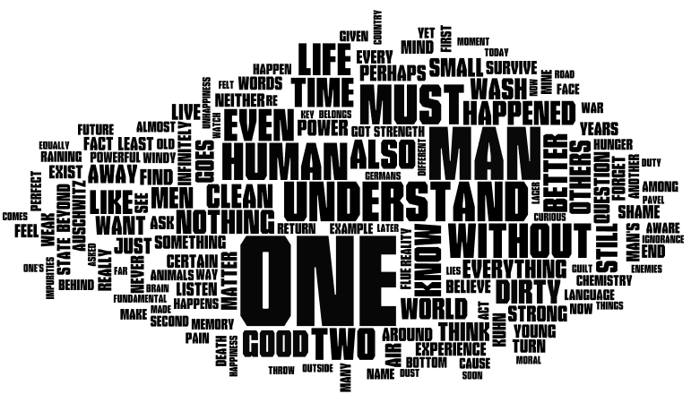
Visualisation Methods: Word Clouds
Single words, the importance of each is shown with font size or colour.
When used as website navigation aids, the terms are hyperlinked to items associated with the tag.
Word Cloud (www.wordle.net)

Slide 8
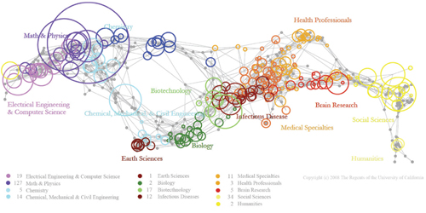
Visualisation Methods: Network Analysis
UCSD Map of Science (Zoss and Borner)

Slide 9
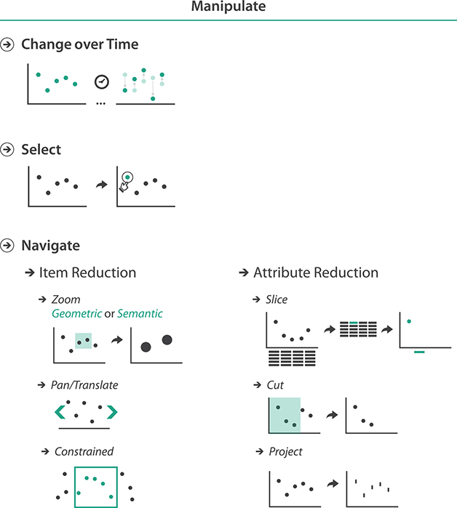
Changing the View
Ability to interact with a graphic is a key benefit of computer over print
Adds functionality, but must be done with care to get the full benefit
Also relates to managing multiple linked views and reducing items and attributes

Slide 10
Final thoughts
This is a timely course – it has been a pandemic illustrated by graphics of many different types
Just as the population has learned about infection models (and the dreaded ‘R’), it has also learned the value of log scales on graphs
A wide range of topics:
Heat map of hospital admissions https://twitter.com/jburnmurdoch/status/1322233070137806850/photo/1
Change in acceptance of vaccination in France over time https://twitter.com/coulmont/status/1353255871552352256
False information: https://time.graphics/line/455000

Slide 11
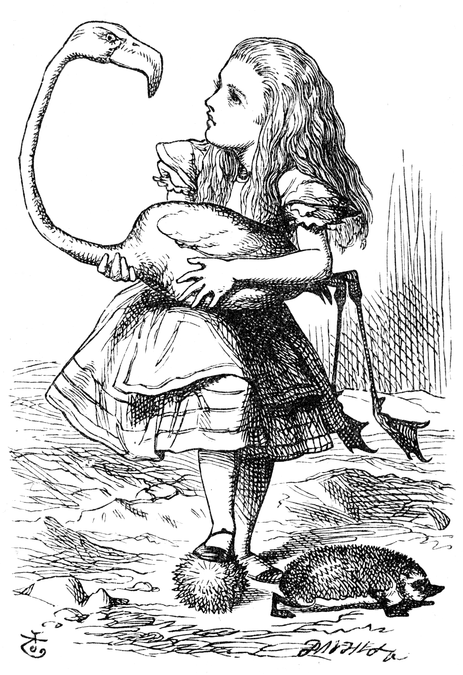
Conclusions
We need to understand the vast quantities of data that surround us; visualisation and machine learning can help us in that task.
Models can be used to uncover the hidden meanings of data.
Visual analytics is a powerful tool that provides insight to non-specialists.
It is a multivariate, multi-skilled, collaborative effort.
It can be beautiful – and fun! https://richardbrath.wordpress.com/2021/10/31/58-ways-to-visualize-alice-in-wonderland/

